Slide 1
UNIT I
TOURISM SYSTEM
Topic:
Lapier Tourism System Model

Slide 2
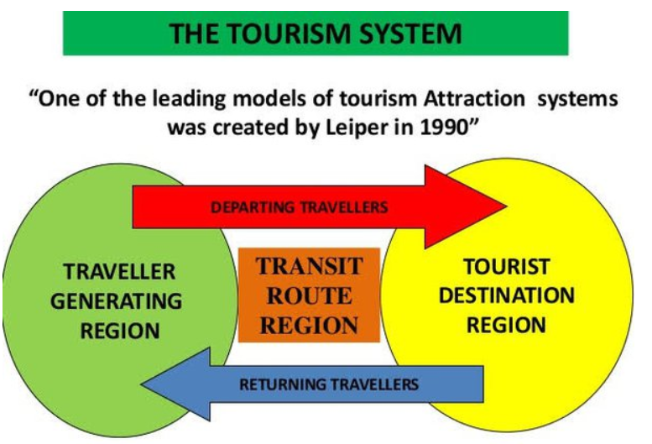

Slide 3
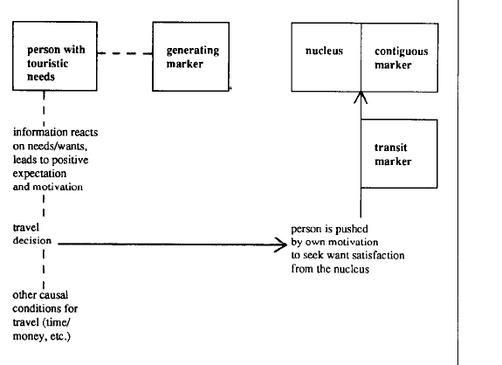

Slide 4
Tourist attraction
Tourist attraction is a systematic arrangement of three elements
Person with touristic needs: Travelers and tourists
The nucleus: Central element in a tourist attraction system.
Markers: Items of information about any phenomenon that is a potential nuclear element in a tourist attraction.

Slide 5
Markers
Generating marker: information received before setting out for the place where nucleus in located
Transit marker: information received on route
Contigous marker: at the nucleus

